Slide 1
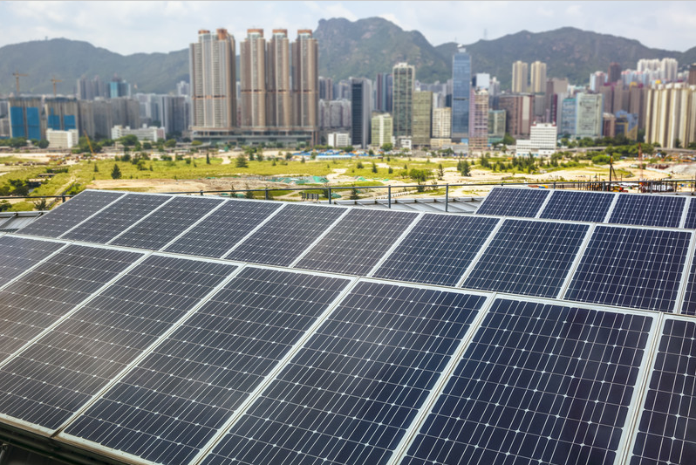
Mass Software Upgrade (MSU)

Slide 2

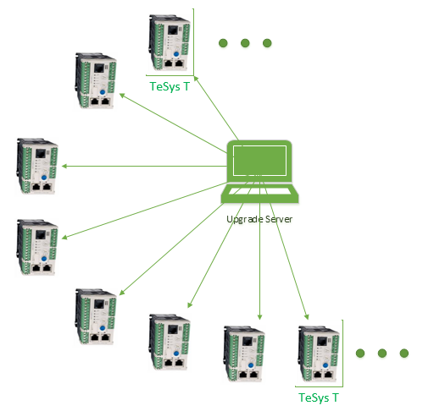
The Case Studies
Case 1:
TeSys-T had a firmware issue due to which 7000 devices had to be reprogrammed.
Problem:
Using the conventional methods of Upgrade using FTP, upgrading 7000 devices can take 24 days! Considering 5 minute for 1 device
Case 2:
Gemasolar plant has 2650 devices for mass upgrade.
Problem:
Using SGBackup tool, it takes 6 hours to upgrade 2650 devices. There are plans to add yet another plant with 10000+ devices, further increasing the maintenance time requirement.
The Catch:
Maintenance in a typical solar power plant is allowed 8-10 hours (non-operating hours in the day when there is no sunlight).

Slide 3

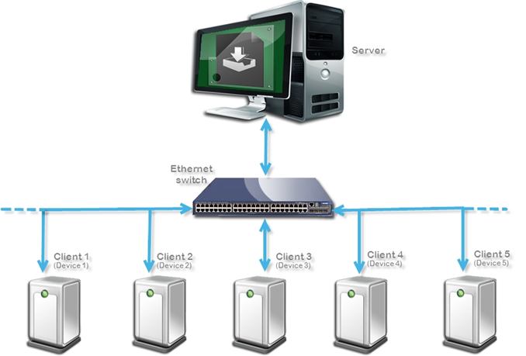
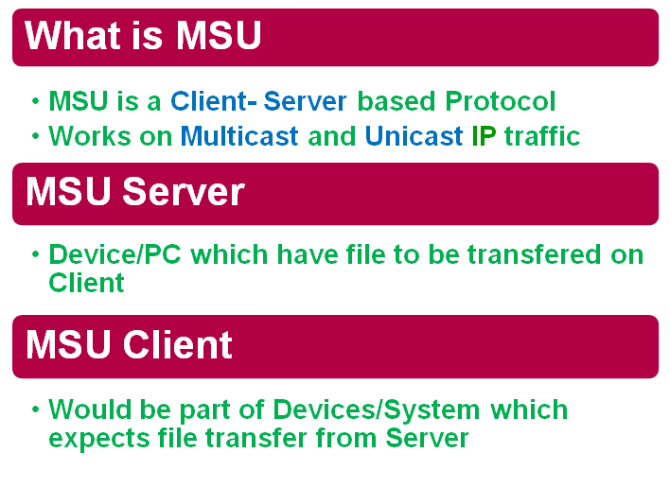
Mass Software Upgrade (MSU) Protocol
This protocol enables the same mass upgrade at an exponentially small time.
TeSys T case, MSU can perform the upgrade for 7000 devices in 2.3 hours!
This is achieved by creating 28 subnets each of 254 devices, and upgrade one @ time
28 subnets taking 28* 5 minutes = 2.3 hours.

Slide 4

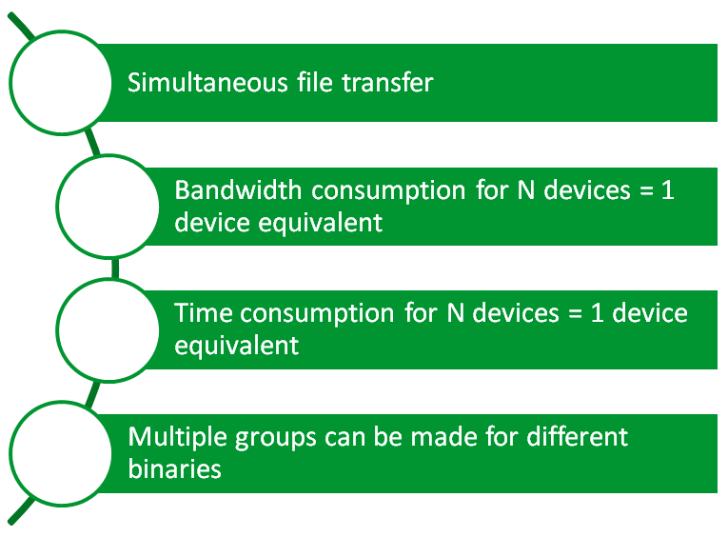
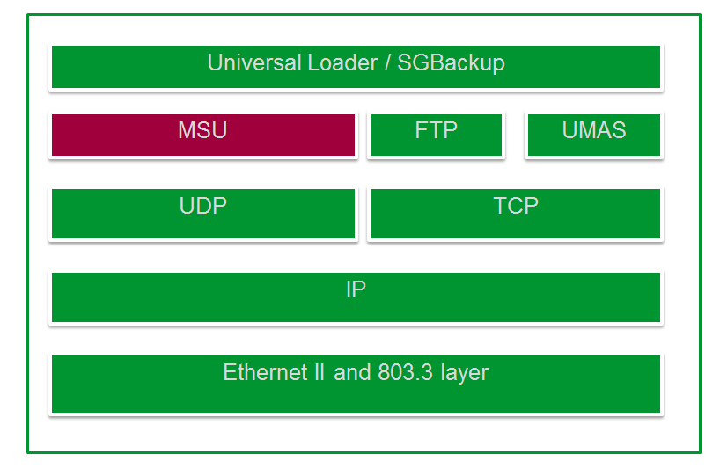
Why MSU?

Slide 5


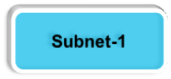
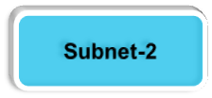



























MSU Architecture Solution
MSU
Aprox 5 Minute per step
5*10ring =50Min ~= 1:00Hr
Sever
Primary Network
Step-1
Step-2
Step -n

Slide 6
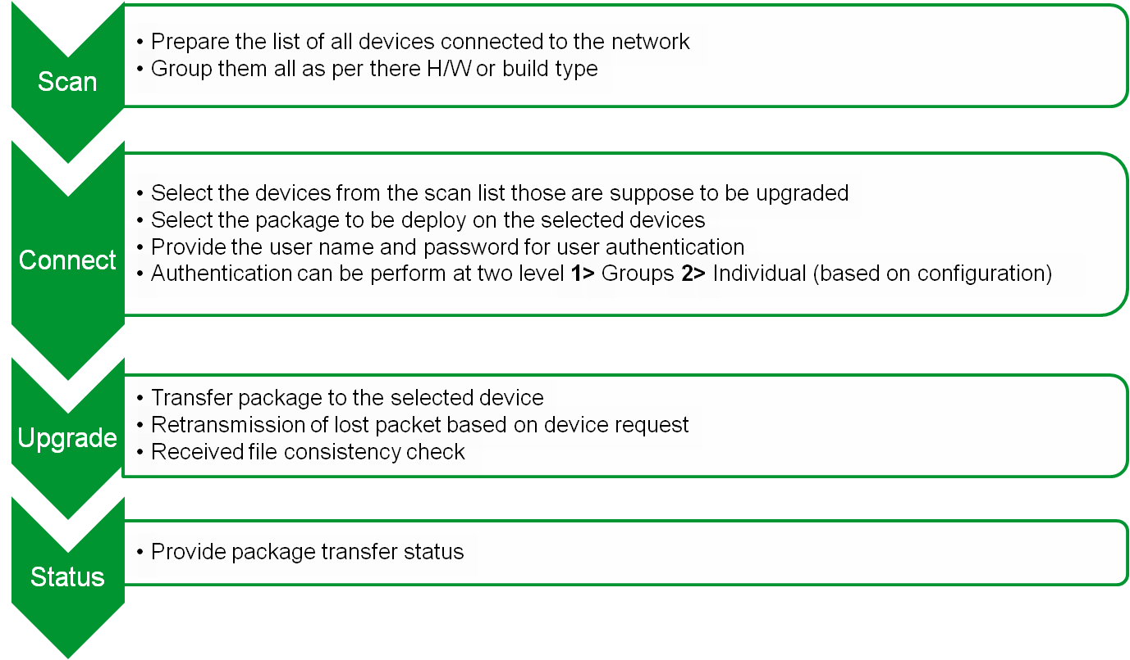
Steps to complete the upgrade process

Slide 7
Package Upgrade Using MSU
Cloud/
Repository
MSU Server
Network
Interface
Get Identification
Network
Interface
Network
Interface
Network
Interface
Device
Device
Device
Data
Exchange
Download Package
Data
Exchange
Package
Firmware
Interface
Firmware
Interface
Firmware
Interface
MSU
Package
Package
Package

Slide 8
Thank you for your kind attention !

